Slide 1

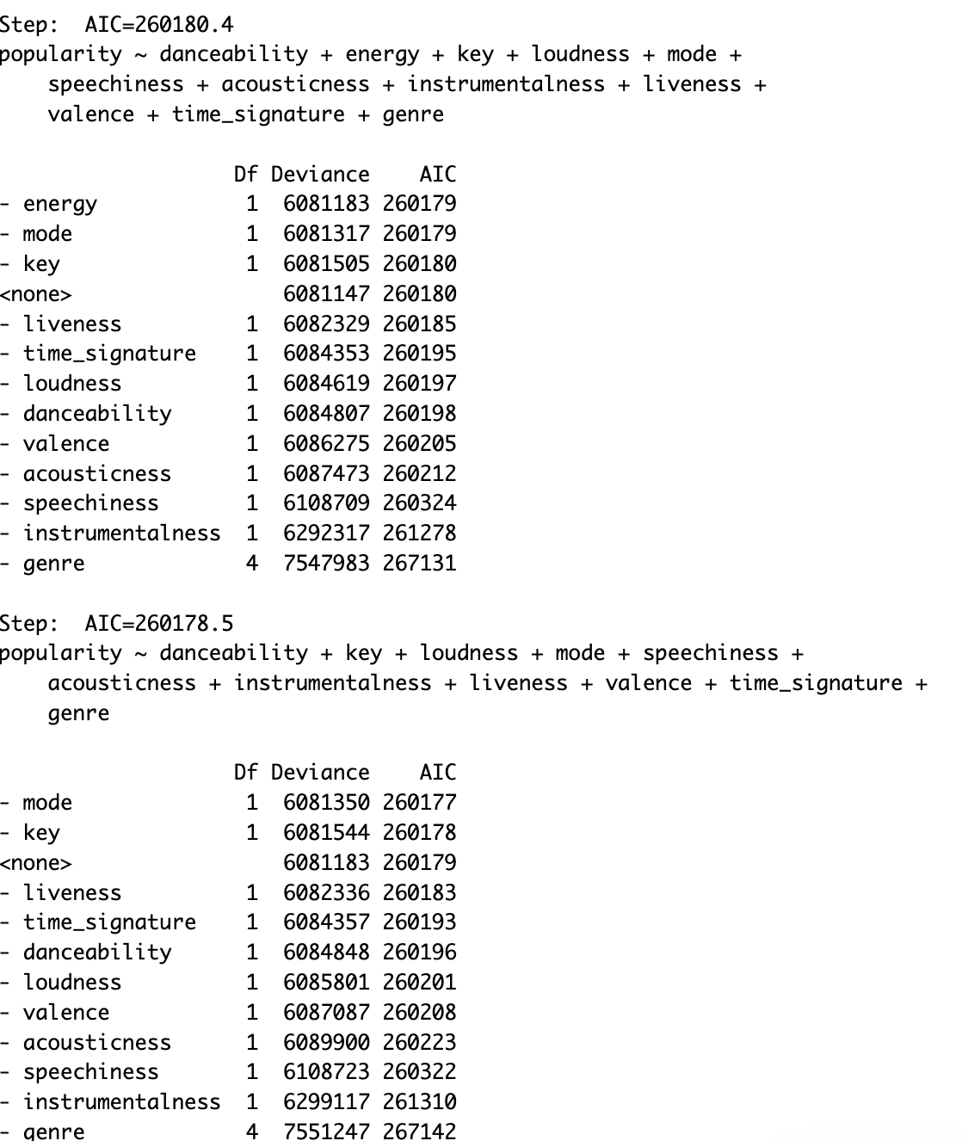
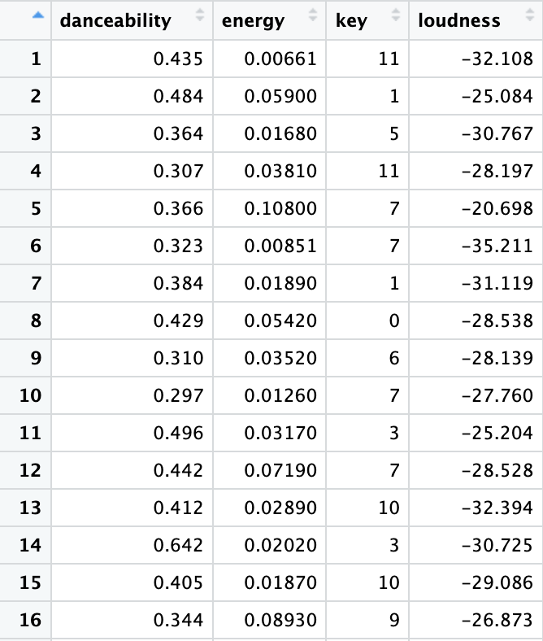
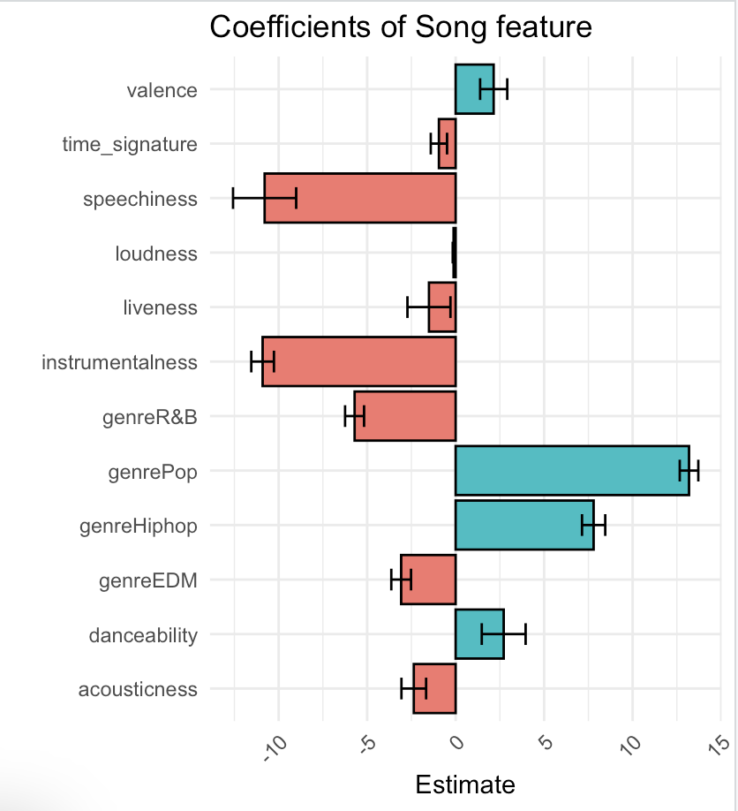
Spotify popularity prediction
Benson yang - Linear regression
1.Data cleaning
2.Model training
3.Result analysis
Notes:
First, a great model is based on appropriate data cleaning, we remove the irrelated variables that doesn’t help with the analysis.
Second, I use linear regression to train the model and predict the new song data.
Finally, I analysis the result and show how this model can impact industry.

Slide 2
Feature selection :
keep :
"danceability", "energy", "key", "loudness", "mode", "speechiness", "acousticness", "instrumentalness", "liveness", "valence", "tempo", "duration_ms", "time_signature", "song_name", "popularity", "genre"
remove :
Index, type, id, url, track_href, analysis_url, artist, classification, error
Summary :
We keep most of the song features. Those features will be the main variables when we analyze the popularity.
We remove the variables that are indirect or unrelated to the popularity. those variables are just something for debugging.
Notes:
First, a great model is based on appropriate data cleaning, which means we have to filter and refine our dataset carefully. In this case, we keep all the song feature that represent the song. Also, we removed the debug varirables, such as error. Those variables are just for us programmer.

Slide 3
Model Introduction :
Linear regression :
Correlation analysis: Linear regression can help determine the strength of the correlation between characteristics and the target variable.
Parameter estimation: The linear regression model provides estimates of the coefficients on the characteristics.
Summary :
In this case, We can know which variable will significantly relate to popularity by linear regression.
using this algorithm, we can know how those variables impact the popularity.
Notes:
Model introduction.
By Linear regression, we can understand how much each variables can impact our target variable Popularity.

Slide 4
Model Training :
We split the dataset to 80:20. 80% for training the model, 20% for testing the model.
We add the testing data one by one, and also immerge every new data to training set and re-train the model again, then record the accuracy.
We use the “AIC stepwise” method to determine which Linear model would be better.
The goal of the AIC Stepwise method is to find models with good fit and fewer independent variables to avoid overfitting and to improve the explanatory power of the model. AIC is built on the basis of maximum likelihood estimation. It is a statistical method used to estimate the most probable values of model parameters given the data.
Summary :
In order to automatic retrain the model, We use AIC stepwise to estimate every possible variables combination, then choose the best one.

Slide 5
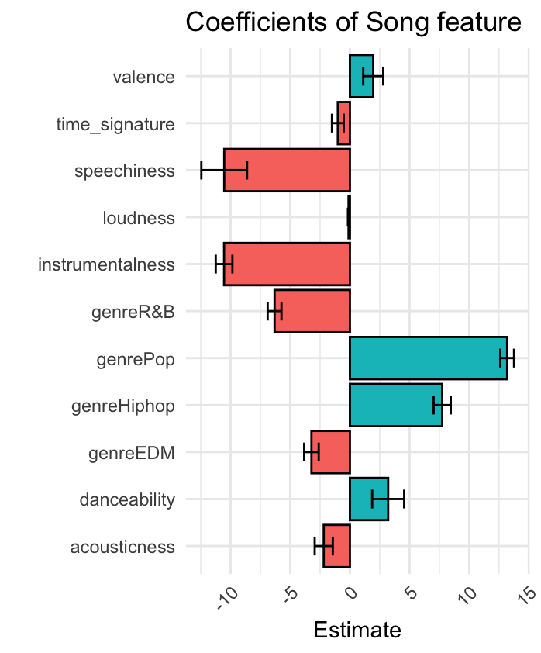
Model Result :
Coefficients: | Estimate | Std. Error | t value | Pr(>|t|)
(Intercept) | 59.85324 | 1.09482 | 54.669 | < 2e-16 ***
valence | 1.95521 | 0.41823 | 4.675 | 2.95e-06 ***
time_signature | -1.01222 | 0.24604 | -4.114 | 3.90e-05 ***
speechiness | -10.5358 | 0.95817 | -10.996 | < 2e-16 ***
loudness | -0.11238 | 0.02596 | -4.329 | 1.50e-05 ***
Instrumentalness | -10.54805 | 0.34993 | -30.143 | < 2e-16 ***
genreR&B | -6.31465 | 0.28981 | -21.789 | < 2e-16 ***
genrePop | 13.18287 | 0.28803 | 45.769 | < 2e-16 ***
genreHiphop | 7.73666 | 0.35891 | 21.556 | < 2e-16 ***
genreEDM | -3.22377 | 0.30477 | -10.578 | < 2e-16 ***
danceability | 3.20835 | 0.6706 | 4.784 | 1.72e-06 ***
acousticness | -2.19344 | 0.37919 | -5.785 | 7.35e-09 ***
According to this analysis, there’s three variables highly determine the popularity.
1.Speechiness 2. instrumentalness 3. GenrePop.
Nowaday, Most people love Pop music, and.
If the song is classify as pop music, it will have great advantage in popularity.

Slide 6
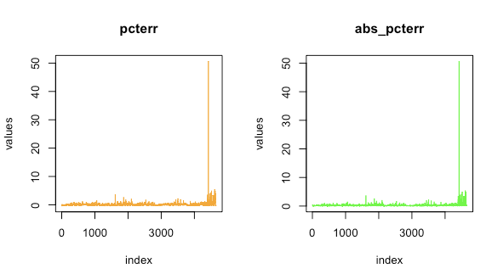
Accuracy:
This is the prediction accuracy, we record accuracy row by row.
By this record, we measure the average accuracy :
abs_err average 10 = +-5 score range
abs_pcter average 0.235 = +-12% score range
Summary :
For the prediction, it has
5 ~ -5 pts error.
12~ -12% error.

Slide 7
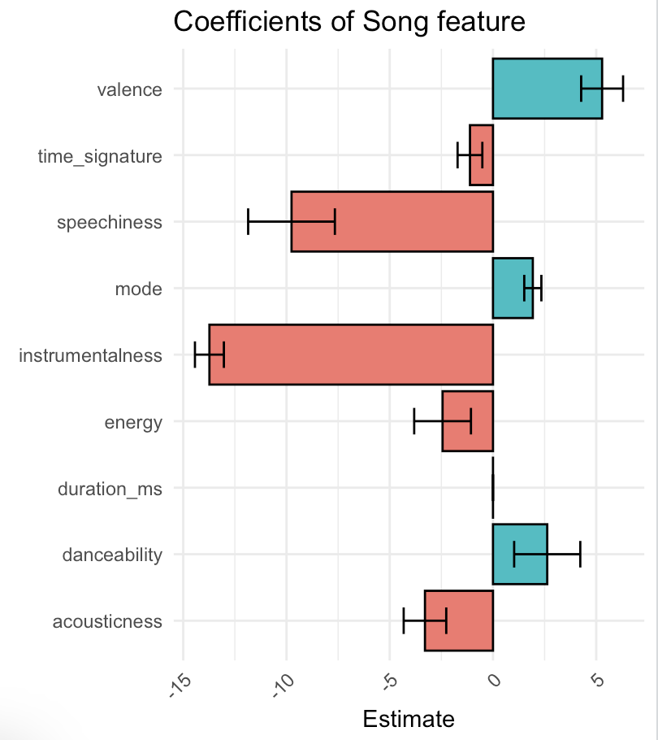
Model Result :
Coefficients: | Estimate | Std. Error | t value
(Intercept) | 65.77 | 1.39 | 47.501
danceability | 2.63 | 0.80 | 3.28
energy | -2.44 | 0.69 | -3.554
mode | 1.93 | 0.21 | 9.303
speechiness | -9.76 | 1.05 | -9.291
acousticness | -3.29 | 0.52 | -6.39
instrumentalness | -13.73 | 0.35 | -39.219
valence | 5.29 | 0.51 | 10.417
duration_ms | 0.00 | 0.00 | -7.458
time_signature | -1.12 | 0.30 | -3.725
According to this analysis, there’s three variables highly determine the popularity.
1.Valence 2. Speechness 3. Danceability.
Notes:
Nowaday, Most people love higher Valence song. Also, if the song has lower Speechness and higher Danceability, It would have higher poplurity.
Those evidence shows that “Nowaday, most people love happy song with some melody and rhytm can make people dance.”
Furthermore, For most people, acoustic music or some song singing like talking are not Priority option.

Slide 8
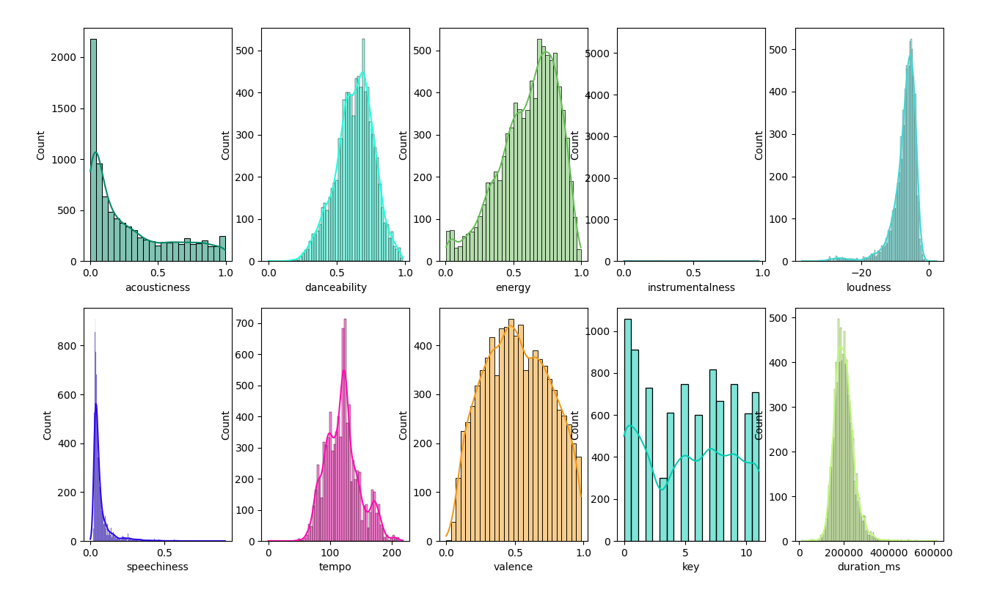

Model Result :
According to this analysis,
“Pop music”
Is the most suitable for those conditions.
Notes:
According to the analysis we observe that pop music is highly match this pattern.
We can say that in recent year pop music is the main music grene for sure.
It has lower acoustic and speechness, and most important usually was a happy song.

Slide 9
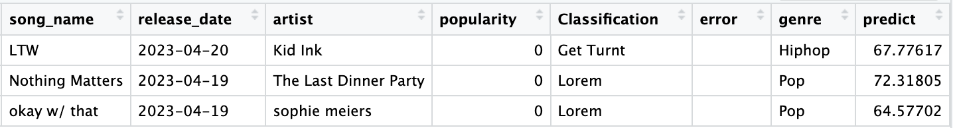
Model Applications :
We can use those model to predict new song’s popularity. By knowing how each variables would effect the song’s popularity, we can know what kind of music would impact the market well.
For music companies, predicting the popularity of new songs can help them assess the potential and market value of artists and thus make more informed signing decisions.
Marketing and promotion strategies: Understanding the popularity of new songs can help music companies and artists develop more effective marketing and promotion strategies.
Notes:
We realize when a song release, it won’t have a precise popularity in short term. Therefore, if a music company can know how will it be famous and popular before the market.
They can build their marketing strategy more reliable and procastly.
Additionally, when people analysis the song, we may put a lot of emotional and subjective opinion inside it, and the final .
THIS model can help us to analysis a song by every one’s opinion, which is the popularity.

Slide 10
Conclusion and Outlook :
It is a new method to analysis music influence.
By those machine learning technique, We can evaluate a music without too much subjective opinion.
This model can be easy to extend, such as using it to analysis the album of each artist . By analysis the album, we can know what kind of song order and type will have more popularity.
Music management company or party music remixer can using this model to select a music order and type that Make the listener feel more the tension of the music.
Outlook :
If we collect data longer, we can create a time series dataset. We can know the popularity wave of each song.
By this dataset, we can analysis the popularity tension of every album during the time.
Notes:
To sum up, all kind of music have their advantage and market. However, positiveness and danceable song will have more chance to be popular in music market. And Pop music
For future work, we focus on time series. Because if we keep collecting the song data, we can analysis the popularity changing wave.
By that wave, we analysis what kind of song can keep popular longer.

